Slide 1
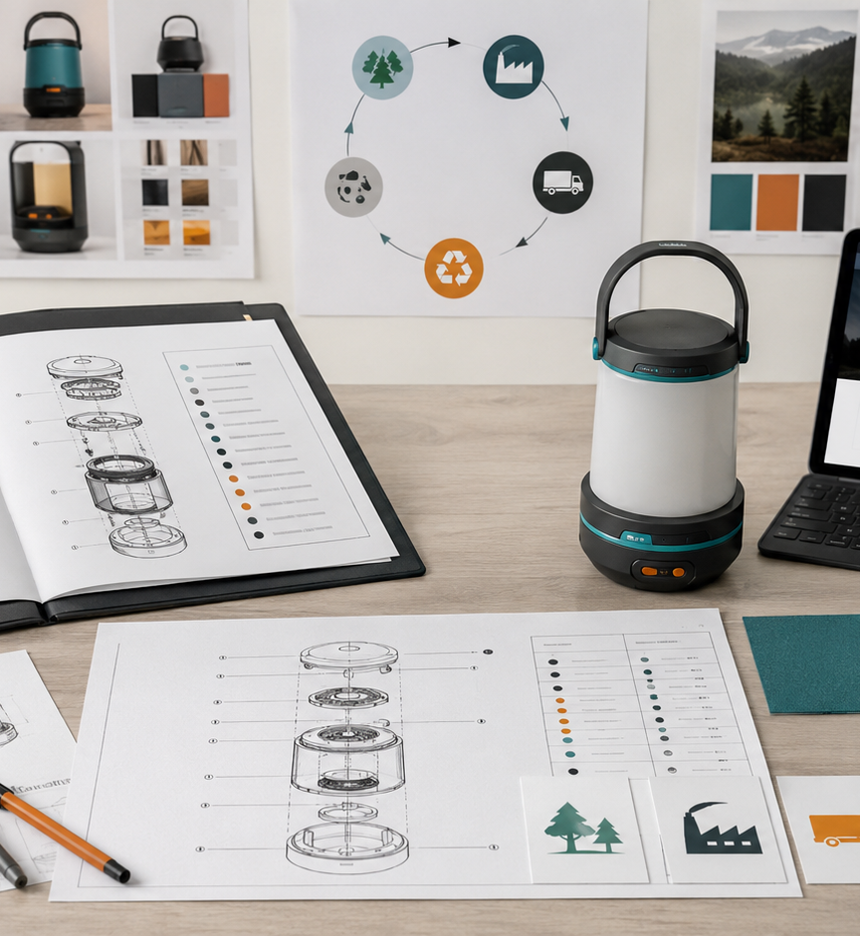
SESSION 6
Production Manual,
Sustainability
and Digital Output
How the product is made, assembled, maintained, and presented as a website or app prototype.
Production report fragment
Digital report output
Specification of Products and Services

Slide 2
SESSION 6
Why this session matters
From technical decisions to a production-ready story.
Before
Today
After
Requirements, materials, drawings, BOM and validation plan exist as separate sections.
Organize how the product is produced, assembled, checked, maintained and handled over time.
The final report can become a complete product specification package plus a user-facing webpage or app.
Key idea: the final project is not only a render. It must explain production logic and communicate the product clearly.
Specification of Products and Services

Slide 3
SESSION 6
Session 6 deliverable
Production Manual, Sustainability, Life Cycle and Digital Output Report
#
Section
What must create
01
Production overview
How the product could be manufactured.
02
Production flow
Steps from material sourcing to finished product.
03
Assembly + quality control
How parts are joined and checked.
04
Maintenance + repair
How the user cleans, stores, repairs or replaces parts.
05
Sustainability + life cycle
How the product reduces waste and what happens at end of life.
06
Digital output
Website, GitHub Pages, app mockup or Expo Go prototype.
Suggested length: 6–10 pages. Use images, tables, diagrams and short captions.
Specification of Products and Services

Slide 4
SESSION 6
Production flow
Must explain the sequence, not just list materials.
1
Source materials
2
Make parts
3
Assemble
materials, hardware, suppliers
cut, sew, print, mold, CNC, weld
join parts, modules, fasteners
4
Test
5
Inspect
6
Maintain
load, fit, leak, comfort, function
quality checklist before delivery
clean, replace, repair, recycle
Specification of Products and Services

Slide 5
SESSION 6
Maintenance, repair and life cycle
A robust product must explain what happens after the user buys it.
Maintenance
Repair / replacement
Life cycle
How to clean, store, dry, charge, wash, lubricate or protect the product.
Which parts can be replaced instead of discarding the entire product.
Material sourcing, manufacturing, distribution, use, maintenance and end of life.
Stage
Question to answer
Material sourcing
Where do materials or parts come from?
Use phase
How long should it last and how is it maintained?
Repair phase
What can be replaced, reused or upgraded?
End of life
What can be recycled, separated, returned or disposed?
Specification of Products and Services

Slide 6

SESSION 6
Digital output options
The visual/commercial report can become a simple website, app mockup or digital page.
GitHub Pages
Best for publishing a simple public class/product website from a repository.
Expo Go
Best for testing a mobile app prototype on a phone without building a final app store version.
Notion / Google Sites / Canva
Best for fast digital dossiers when the focus is documentation and visual clarity.
Specification of Products and Services

Slide 7
SESSION 6
How production content becomes digital content
Use the same evidence, but write it for a different audience.
Production / technical report
Website or app language
Ripstop nylon with reinforced stitching
Durable fabric made for daily movement
Replaceable buckle and modular strap system
Repairable parts that extend product life
Quality control: load and attachment test
Tested for secure everyday use
Maintenance: wipe clean and air dry
Easy to clean after daily use
End-of-life: disassemble textile and hardware
Designed to be repaired, reused or recycled
Do not copy the technical paragraph into the web/app. Translate it into user benefits.
Specification of Products and Services

Slide 8
SESSION 6
NotebookLM prompt for Session 6
Use NotebookLM to draft the report, then edit and verify.
Using only the uploaded sources, create a Session 6 report titled “Production Manual, Sustainability and Life Cycle”.
Include: production overview, production flow, assembly sequence, tools and processes, quality control checklist, maintenance instructions, repair/replacement strategy, sustainability strategy, product life cycle, basic norms/references, missing information and next steps.
Also suggest how the same content can become a website, GitHub Pages page, Expo Go app prototype or digital dossier.
Do not invent final data. If information is missing, write “to be defined”, “needs supplier”, “needs testing” or “needs evidence”.
Specification of Products and Services

Slide 9
SESSION 6
What to submit for Session 6
A concise report fragment that can be integrated into the final report.
#
Checklist
01
Cover / header with project name and main image
02
Production overview and production flow
03
Assembly sequence and tools/processes
04
Quality control checklist
05
Maintenance, repair and replacement strategy
06
Sustainability strategy and life cycle diagram
07
Digital output plan: website, GitHub Pages, app or dossier
08
Missing information and next steps
Specification of Products and Services

